Slide 1
LINUX
An Introduction
By
Jamil Ahmad

Slide 2
CONTENTS
Overview of Linux OS
Linux Installation (Ubuntu)
Understanding it
Using it

Slide 3
OVERVIEW OF LINUX OS

Slide 4
WHAT IS LINUX?
Developed in 1991 by a University of Finland student Linus Torvalds.
Basically a kernel, it was combined with the various software and compilers from GNU Project to form an OS, called GNU/Linux
Linux is a full-fledged OS available in the form of various Linux Distributions
RedHat, Fedora, SuSE, Ubuntu, Debian are examples of Linux distros
Linux is supported by big names as IBM, Google, Sun, Novell, Oracle, HP, Dell, and many more

Slide 5
HISTORY OF LINUX
Inspired by the UNIX OS, the Linux kernel was developed as a clone of UNIX
GNU was started in 1984 with a mission to develop a free UNIX-like OS
Linux was the best fit as the kernel for the GNU Project
Linux kernel was passed onto many interested developers throughout the Internet
Linux today is a result of efforts of thousands of individuals, apart from Torvalds

Slide 6
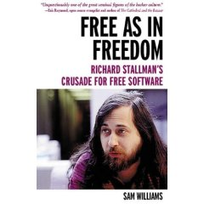
GNU PROJECT
  Established in 1984 by Richard Stallman, who believes that software should be free from restrictions against copying or modification in order to make better and efficient computer programs
  GNU is a recursive acronym for “GNU's Not Unix”
  Aim at developing a complete Unix-like operating system which is free for copying and modification
  Companies make their money by maintaining and distributing the software, e.g. optimally packaging the software with different tools (Redhat, Slackware, Mandrake, SuSE, etc)
  Stallman built the first free GNU C Compiler in 1991. But still, an OS was yet to be developed

Slide 7
LINUX - FREE SOFTWARE
Free software, as defined by the FSF (Free Software Foundation), is a "matter of liberty, not price." To qualify as free software by FSF standards, you must be able to:
  Run the program for any purpose you want to, rather than be restricted in what you can use it for.
  View the program's source code.
  Study the program's source code and modify it if you need to.
  Share the program with others.
  Improve the program and release those improvements so that others can use them.

Slide 8
WHY IS IT SIGNIFICANT?
Growing popularity
Powerful
  Runs on multiple hardware platforms
  Users like its speed and stability
  No requirement for latest hardware
It’s “free”
  Licensed under GPL
  Vendors are distributors who package Linux

Slide 9
WELL KNOWN USERS
Google
  Google is the world's largest search engine. It runs on Linux.
Amazon
  Amazon is the world's largest internet bookshop. Amazon.com switched much of its massive internal network to Linux in 2000. By the third quarter of 2001, the company reported saving $17 million, slashing nearly a quarter of its tech expenses.
Akamai
  Akamai has the world's largest content delivery network. They use Linux servers.

Slide 10


LINUX ON SERVERS AND SUPERCOMPUTERS
Linux is the most used OS on servers
5 out of 10 reliable web hosting companies use Linux
Linux is the cornerstone of the LAMP server-software combination (Linux, Apache, MySQL, Perl/PHP/Python) which has achieved popularity among developers
Out of top 500 supercomputers, Linux is deployed on 426 of them

Slide 11
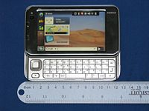
LINUX ON EMBEDDED SYSTEMS
16.7% of smartphones worldwide use Linux as OS
Linux poses a major competition to the most popular OS is this segment – Symbian
Nokia, Openmoko supply Linux on their select smartphones

Slide 12
LINUX ON OTHER DEVICES
Linux can be used on a wide range of electronic devices, like PC, PDAs, Smartphones, iPods, MP3 Players, PlayStation 2 & 3, mission critical servers and so on…

Slide 13
WHY SHOULD YOU USE LINUX?
No threat of viruses
Linux systems are extremely stable
Linux is Free
Linux comes with most of the required software pre-installed
Update all your software with minimum fuss
Linux never gets slow
Linux does not need defragmentation
Linux can even run on oldest hardware
Adding more software is a matter of a few clicks
Most Windows-only apps have their either their native version or alternatives for Linux
With Linux, you get the highest degree of possible customizability
It is possible to install/run Windows software on Linux
Wine helps run a wide range of Windows applications
Cedega helps run huge number of Windows games flawlessly

Slide 14
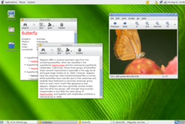
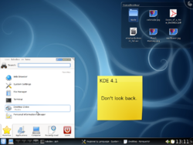
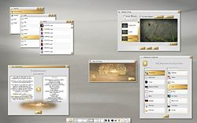
LINUX USER INTERFACE
Can be controlled through command-line (CLI) or Graphical User Interface (GUI)
GUI run through Desktop Environments (DE)
KDE, GNOME, Xfce, E17 are popular DEs
The GUI interface is easy-to-use and much like that of Windows and Mac OSX
The CLI is similar to that of UNIX/BSD

Slide 15
LINUX INSTALLATION

Slide 16
INSTALLING LINUX
Linux can be installed on a PC from a CD/DVD as the only OS on the system. All disk space will be available to it.
It can be installed along side Windows OS. Some disk space (usually a single partition) will be used by the Linux OS.
Several Linux distributions have Live CDs/DVDs allowing it to run from a CD/DVD without install.
A Live CD/DVD can also be installed onto a USB Flash Drive.
Ubuntu Linux allows it to be installed within Windows just like an ordinary application without modifying the file system at all. i.e. No partition will be used by it instead just some space on the disk (two large files: ext3fs [several GBs] and swap [several 100 MBs]) will be used by it and configures the boot loader to load both OSs. (WUBI Project)

Slide 17
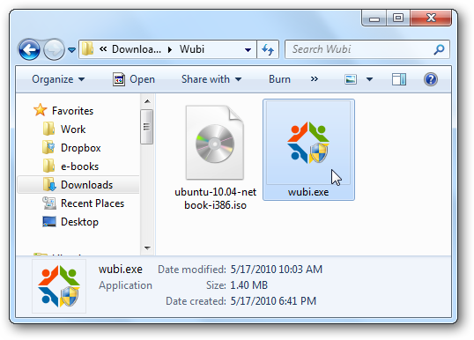

Slide 18
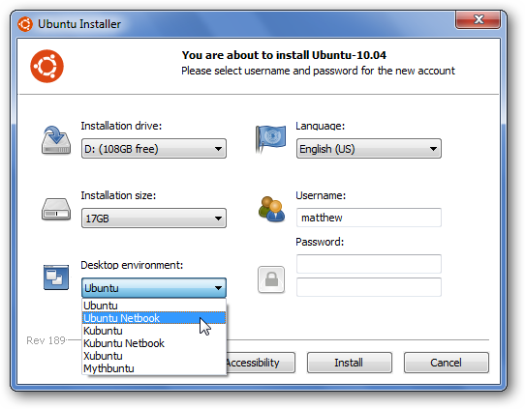

Slide 19
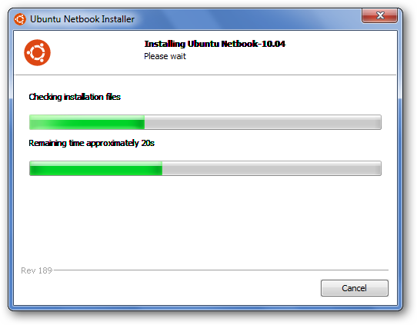

Slide 20
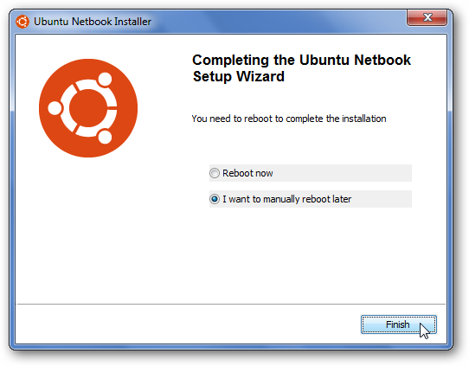

Slide 21
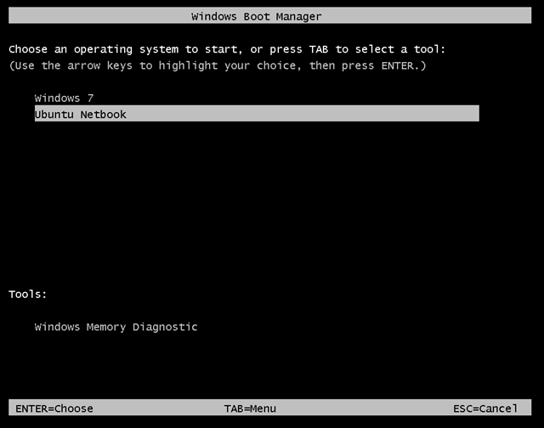

Slide 22
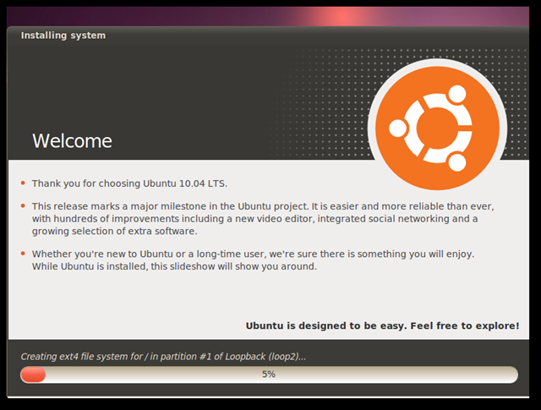

Slide 23
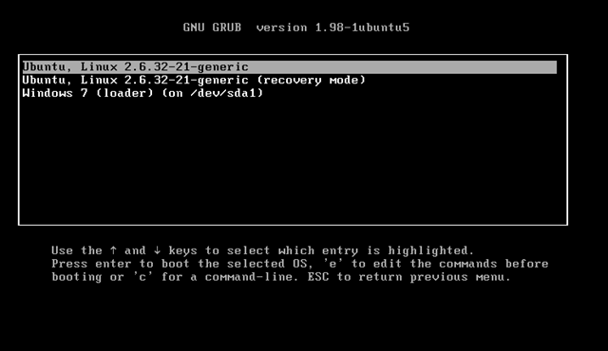

Slide 24
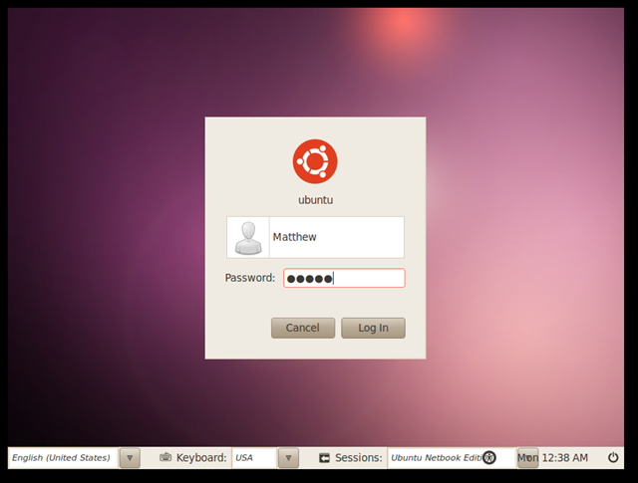

Slide 25
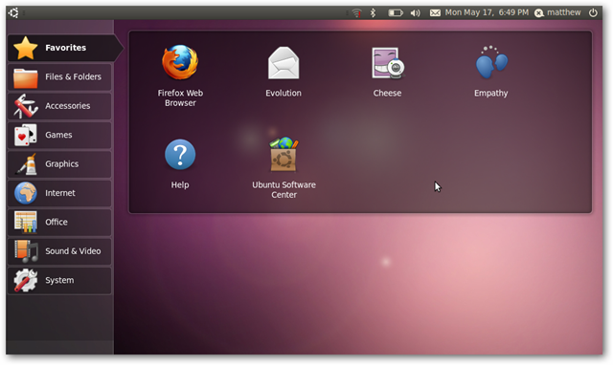

Slide 26
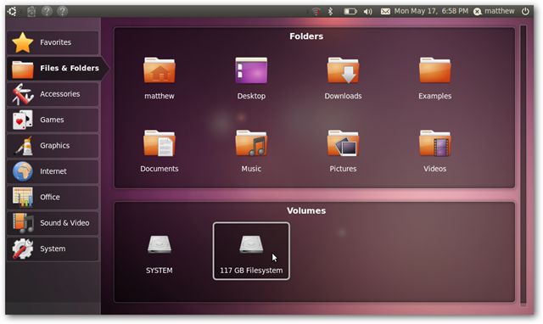

Slide 27
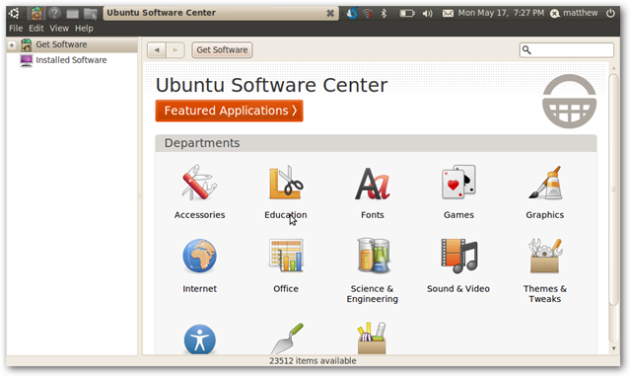

Slide 28
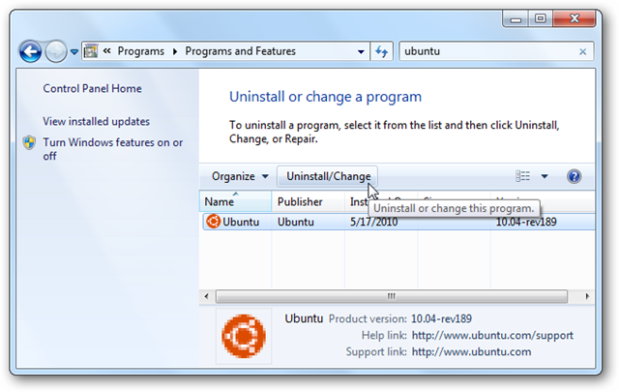

Slide 29
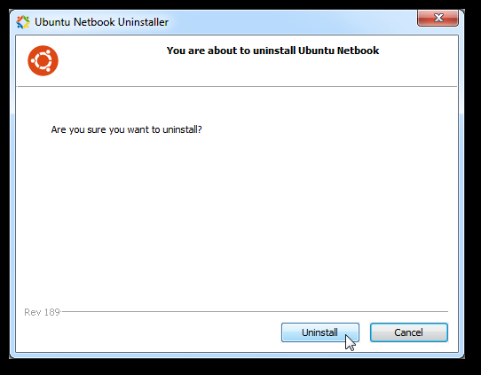

Slide 30
UNDERSTANDING LINUX

Slide 31
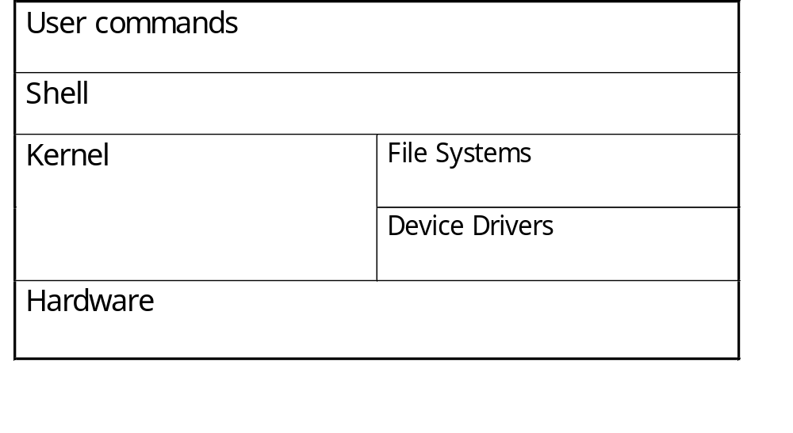
THE LINUX SYSTEM
User commands includes executable programs and scripts
The shell interprets user commands. It is responsible for finding the commands and starting their execution. Several different shells are available. Bash is popular,
The kernel manages the hardware resources for the rest of the system.

Slide 32
LINUX SHELL
whoami
ls
pwd
Shell interprets the command and request service from kernel
Similar to DOS but DOS has only one set of interface while Linux can select different shell
  Bourne Again shell (Bash), TC shell (Tcsh), Z shell (Zsh)
Bash, Tcsh, Zsh
Kernel
Different shell has similar but different functionality
Bash is the default for Linux
Graphical user interface of Linux is in fact an application program work on the shell

Slide 33
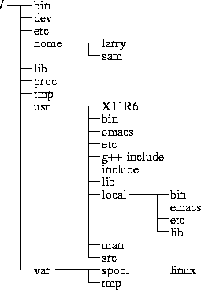
DIRECTORY TREE
(root)
When you log on the the Linux OS using your username you are automatically located in your home directory.

Slide 34
THE MOST IMPORTANT SUBDIRECTORIES INSIDE THE ROOT DIRECTORY ARE:
/bin : Important Linux commands available to the average user.
/boot : The files necessary for the system to boot. Not all Linux distributions use this one. Fedora does.
/dev : All device drivers. Device drivers are the files that your Linux system uses to talk to your hardware. For example, there's a file in the /dev directory for your particular make and model of monitor, and all of your Linux computer's communications with the monitor go through that file.
/etc : System configuration files.
/home : Every user except root gets her own folder in here, named for her login account. So, the user who logs in with linda has the directory /home/linda, where all of her personal files are kept.
/lib : System libraries. Libraries are just bunches of programming code that the programs on your system use to get things done.

Slide 35
THE MOST IMPORTANT SUBDIRECTORIES INSIDE THE ROOT DIRECTORY ARE:
/mnt : Mount points. When you temporarily load the contents of a CD-ROM or USB drive, you typically use a special name under /mnt. For example, many distributions (including Fedora) come, by default, with the directory /mnt/cdrom, which is where your CD-ROM drive's contents are made accessible.
/root : The root user's home directory.
/sbin : Essential commands that are only for the system administrator.
/tmp : Temporary files and storage space. Don't put anything in here that you want to keep. Most Linux distributions (including Fedora) are set up to delete any file that's been in this directory longer than three days.
/usr : Programs and data that can be shared across many systems and don't need to be changed.
/var : Data that changes constantly (log files that contain information about what's happening on your system, data on its way to the printer, and so on).

Slide 36
USING LINUX

Slide 37
LINUX COMMAND BASICS
To execute a command, type its name and arguments at the command line
ls -l /etc
Command name
Arguments
Options
(flags)

Slide 38
COMMAND OPTIONS
Command options allow you to control a command to a certain degree
Conventions:
  Usually being with a single dash and are a single letter (“-l”)
  Sometimes have double dashes followed by a keyword (“--help”)
  Sometimes follow no pattern at all

Slide 39
COMMON COMMANDS
pwd - print (display) the working directory
cd <dir> - change the current working directory to dir
ls - list the files in the current working directory
ls -l - list the files in the current working directory in long format

Slide 40
FILE COMMANDS
cp <fromfile> <tofile>
  Copy from the <fromfile> to the <tofile>
mv <fromfile> <tofile>
  Move/rename the <fromfile> to the <tofile>
rm <file>
  Remove the file named <file>
mkdir <newdir>
  Make a new directory called <newdir>
rmdir <dir>
  Remove an (empty) directory

Slide 41
MORE COMMANDS
who
  List who is currently logged on to the system
whoami
  Report what user you are logged on as
ps
  List your processes on the system
ps aux
  List all the processes on the system
echo “A string to be echoed”
  Echo a string (or list of arguments) to the terminal

Slide 42
THE END

